Slide 1


Types of Graph Designs
Gilbert Carrillo

Slide 2


Types of Designs We Will Talk About
Distribution Designs
Single Distributions
Multiple Distributions
Correlation Designs
Geospatial Designs

Slide 3
Distribution Designs
Best for one or more sets of values that can be spread across a range from low to high.

Slide 4
Distribution Designs: Single Distribution
One data set
Counts
Percentages
Can be spread across a range or interval
The type of graph to be used, depends on if you want to show several occurrences in an interval or if you want to see a shape or curve created with the overall data in a range

Slide 5

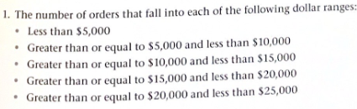
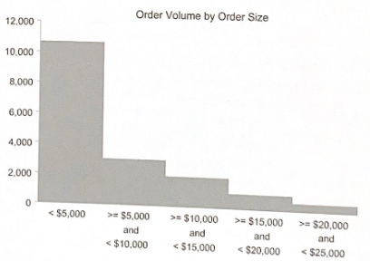
Distribution Designs: Single Distribution Show Several Occurrences
Histograms:
Groups data
Can be horizontal or vertical
Easy to identify which group of data is greater

Slide 6
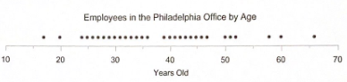
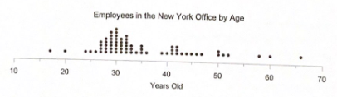
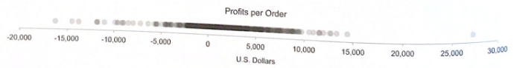
Distribution Designs: Single Distribution Show Several Occurrences
Strip Plot:
Shows each value
Easy to identify individual data points
Data points can be jittered for duplicate data points
Data points can be represented by transparent dots.
The darker the dot, the more occurrences

Slide 7
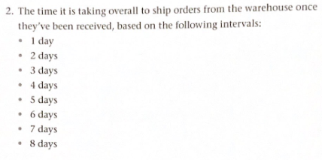
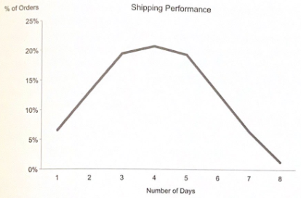
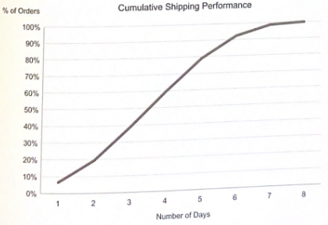
Distribution Designs: Single Distribution See a Shape or Curve Created with the Overall Data
Frequency Polygon:
Focuses the viewers eye on the overall shape rather than the overall amount of data
Great for Cumulative distributions

Slide 8
Distribution Designs: Multiple Distribution
More than one data set
Can be represented by:
Frequency Polygon
Box-and-whisker plot
Three value box plot
Strip plot

Slide 9
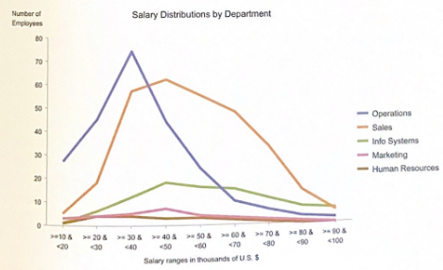
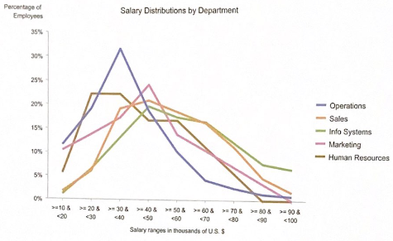
Distribution Designs: Multiple Distribution Frequency Polygon
Frequency Polygon:
Focuses the viewers eye on the overall shape rather than the overall amount of data
Great for Cumulative distributions
Different color lines for each data set

Slide 10
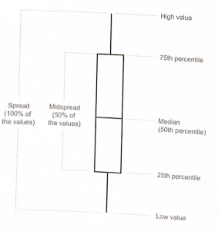
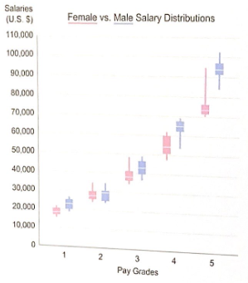
Distribution Designs: Multiple Distribution Box-and-whisker plot
Box-and-whisker plot:
Shows key point data in each data set:
Highest value
Lowest value
Range(spread)
Median
Middle spread

Slide 11
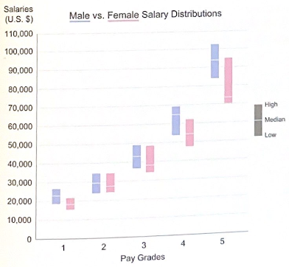
Distribution Designs: Multiple Distribution Three value box plot
Three value box plot :
Data is displayed as a bar
Top of the bar is the highest value
Bottom of the bar is the lowest
The line in the bar is the median

Slide 12
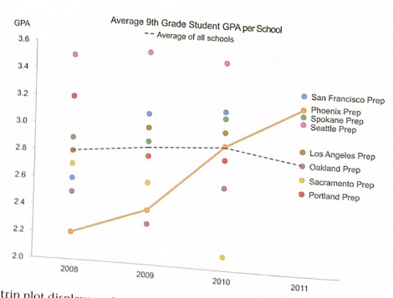
Distribution Designs: Multiple Distribution Strip plot
Strip plot :
Shows each value
Easy to identify individual data points
Each data set is represented by a different color
Lines can be made to help show the flow of data.

Slide 13
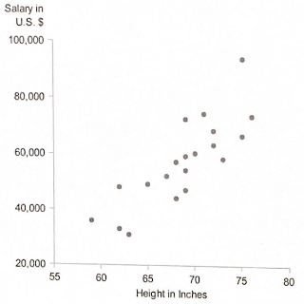
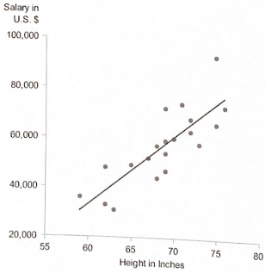
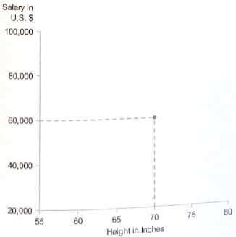
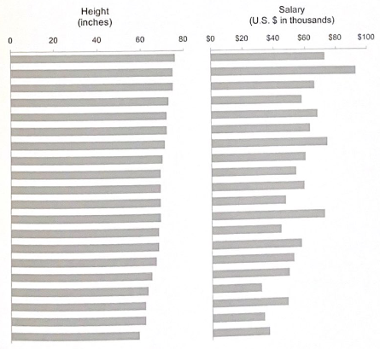
Correlation Designs
Shows any relationship between two sets of values to identify if they are related. If they are related then it shows the direction of that relationship, whether that be positive or negative and either strong or weak
Most of the time represented as a scatter plot
Can also be represented by placing two of the same graph types with different data to compare

Slide 14
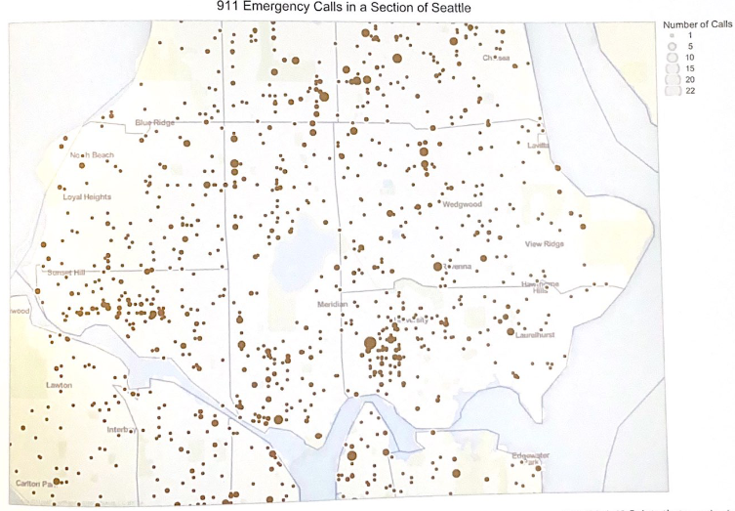
Geospatial Designs
Data points come in the form of:
Location
Positioning values
Points can be different sizes based off the amount of data in that area
Points may be different color intensity
Lines may vary in thickness and color intensity

Slide 15
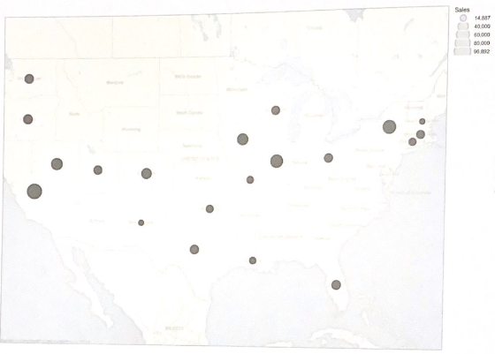
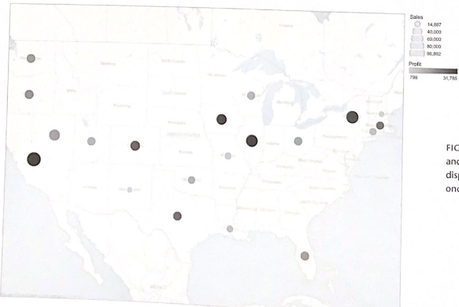
Geospatial Designs
When both different sizes and color variation is used, we can get two data sets in one map.

Slide 16
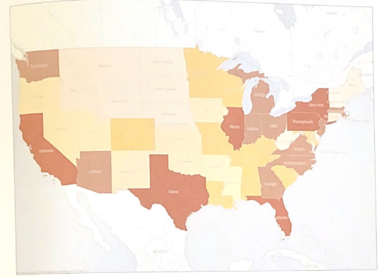
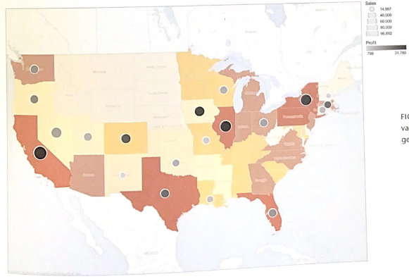
Geospatial Designs
By applying different color intensities to the states, including points and providing color intensity on those points, we can observe three different data sets on one map.
Three sets of data:
Different color for states is population, the darker the more population
Size of circles is sales revenue
The circle color intensity is profit

Slide 17
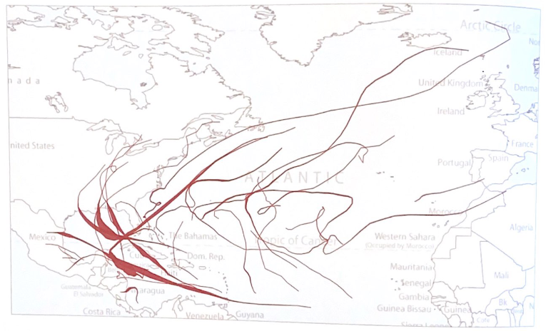
Geospatial Designs
Lines can be used to show a popular path of data.
Cars driving
Storms trajectory
Ship traffic
The thickness represents more common paths as shown above. These paths represent common paths for large storms in the Atlantic ocean during 2005’s hurricane season.

